Slide 1
Department of CSE
Batch No: 09
An Efficient Spam Detection Technique for IoT Devices using Machine Learning
Team Members: N.Nishanth reddy (217R1A0539) S.Nagaraju(227R5A0504) P.Sainath (217R1A0545)
under the esteemed guidance of : Mr.G.Pavan Kumar (Assistant Professor)

Slide 2
Table of contents
Introduction
Existing Systems
Disadvantages
Proposed System
Advantages
Hardware and Software Requirements
Novelty of Project
System Architecture
Use Case Diagram
Class Diagram
Sequence Diagram
Activity Diagram
Sample Code
Result
Conclusion
Future Scope
References
Github Link

Slide 3
Introduction
The Internet of Things (IoT) facilitates the seamless integration of physical devices with the digital world, allowing devices to communicate and exchange data across diverse networks. However, this rapid expansion introduces significant security challenges, including spam attacks, intrusions, and other vulnerabilities. Protecting IoT systems from these threats has become increasingly critical. Machine Learning (ML) offers a powerful solution to address these challenges by enhancing the detection and prevention of spam and other malicious activities in IoT environments, ultimately improving overall security and system reliability.

Slide 4
Existing System
The current system leverages unsupervised machine learning for clustering and reinforcement learning for selecting security protocols, but it has challenges in processing IoT data effectively due to limited resources. It is prone to delays in detecting attacks and susceptible to various forms of compromise.

Slide 5

Disadvantages of Existing System
Traditional methods have several limitations, making them inefficient and vulnerable to spam attacks.
1
Limited Accuracy
2
Lack of Integration
These methods often struggle to accurately detect spam techniques, resulting in false positives and negatives.
Existing systems rely solely on traditional approaches, which fail to address the evolving nature of spam and provide ineffective solutions.
3
Prone to Attacks
4
Difficult to Adapt
Since exisiting system isnt able to detect spam it is highly prone to Attacks.
Traditional methods struggle due to limited resources to estimate the current network and timely attack status.

Slide 6
Proposed System
This System utilizes machine learning algorithms to identify and filter spam in IOT Devices.
Data Collection
1
The system collects data from IoT devices, capturing network traffic and user interactions.
2
Feature Extraction
Key features are extracted from the collected data.
Model Training
3
A machine learning model is trained using labeled datasets, enabling it to recognize spam patterns. We use 5 machine learning models.
4
Spam Detection
The trained model analyzes incoming data, classifying it as either spam or legitimate based on Spam Score which are assigned by ml models.
Filtering
5
Identified spam messages are filtered, preventing them from reaching the intended recipients and disrupting network operations.

Slide 7

Advantages of Proposed System
The proposed system offers significant advantages over traditional spam detection methods.
Improved Accuracy
Enhanced Adaptability
Decision making
Machine learning algorithms can learn complex spam patterns, leading to more accurate detection and reduced false positives.
The system can adapt to emerging spam techniques by continuously learning and refining its detection capabilities.
The System is Faster and provide efficient decision-making process for spam detection.

Slide 8

Hardware Requirements
The proposed system requires hardware capable of handling real-time data analysis and processing.
The system requires a powerful processor to handle the computational demands of machine learning algorithms and data processing. The recommended processor is a single-core Intel Pentium IV processor.
The system requires sufficient RAM to accommodate the data storage and processing requirements. 4GB of RAM is recommended for optimal performance.
The system requires ample storage space for data collection and model training. 20 GB of storage is recommended to accommodate the data requirements.

Slide 9
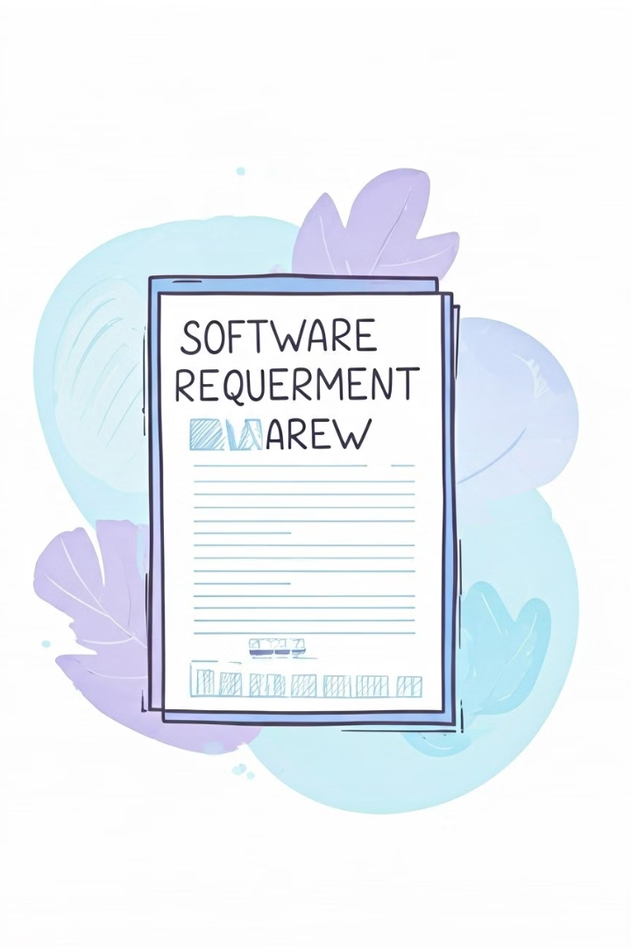



Software Requirements
The system relies on specific software components for effective spam detection.
Operating System
Programing Language
The system requires Windows 11.
The system requires Python 3.8.
Front-end
The project uses HTML, CSS, and Python for the front-end.

Slide 10

Novelty of the Project
The novelty lies in the use of five machine learning models and a computed spam score to assess the trustworthiness of IoT devices. This approach enhances the detection accuracy compared to existing methods.
1
Decision Tree Classifier
2
Gradient Boosting
It helps in segmenting the dataset based on features and outcomes, contributing to the calculation of a spam score. This aids in detecting malicious activities in IoT devices​.
It is used to enhance the accuracy of spam detection by building decision trees, and improving the reliability of identifying spam in IoT devices.
3
K-Nearest Neighbors (KNN) It is used to classify IoT device data based on similarity. It identifies the closest training examples in the feature space to determine whether a new data point represents spam or non-spam.
4
Logistic Regression It is used to analyze the relationship between features of IoT devices and the likelihood of spam occurrence. It predicts whether a device is classified as spam or non-spam based on a binary output (0 or 1),
5
Naive Bayes
It calculates the probability of a device being spam or non-spam based on the individual contributions of each feature. Despite its simplicity, Naive Bayes is efficient and effective in handling large datasets.

Slide 11
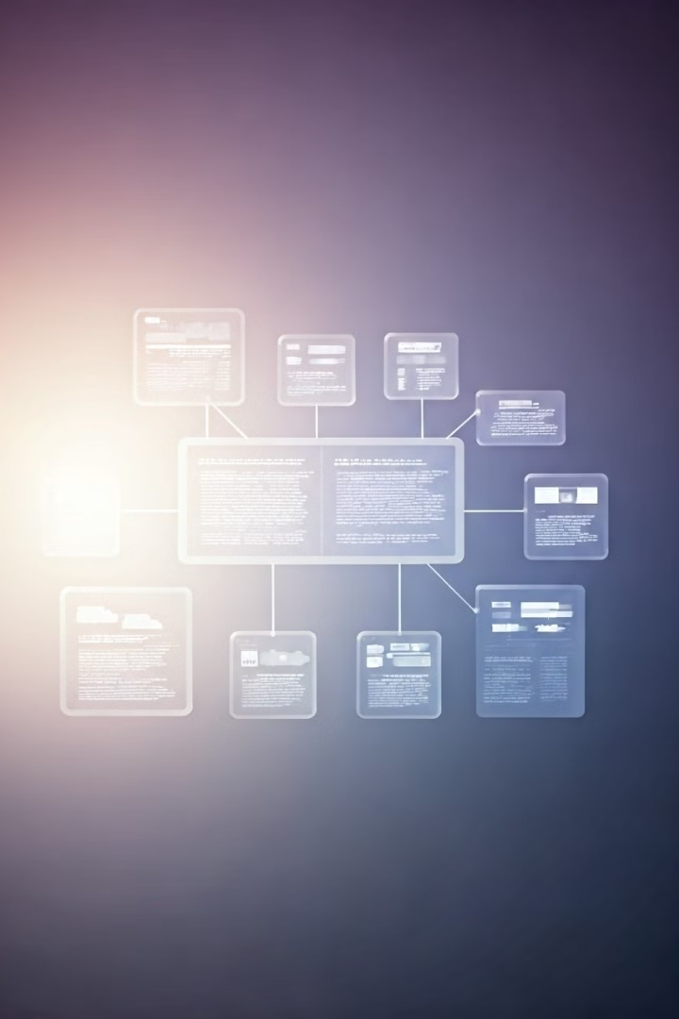
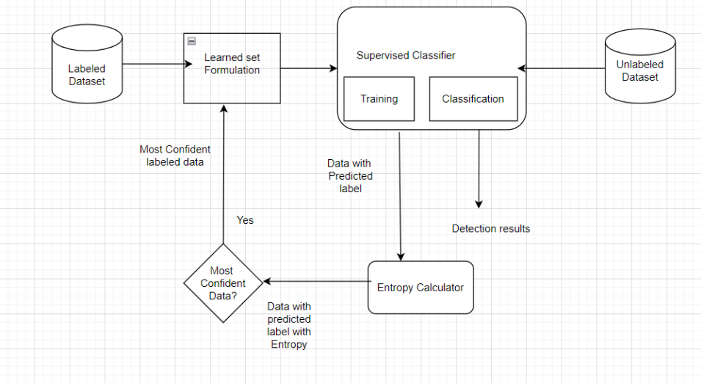
System Architecture
Architecture Diagram:

Slide 12
Modules:
Data Collection: This is the first real step towards the real development of a machine learning model, collecting data. This is a critical step that will cascade in how good the model will be, the more and better data that we get, the better our model will perform.
there are many techniques to collect data like Web Scraping,Manual Intervention.
Dataset In this data set we are taken32 columns and 503910 rows in the dataset, which are described below. •gen [kW] Total energy generated by means of solar or other power generation resources
•House overall [kW]
▪overall house energy consumption
•Dishwasher [kW]
▪energy consumed by specific appliance
•Furnace 1 [kW]
▪energy consumed by specific appliance
•

Slide 13
Furnace 2 [kW]
▪energy consumed by specific appliance
•Home office [kW]
▪energy consumed by specific appliance
•Fridge [kW]
▪energy consumed by specific appliance
•Wine cellar [kW]
▪energy consumed by specific appliance
•Garage door [kW]
▪energy consumed by specific appliance
•Kitchen 12 [kW]
▪energy consumption in kitchen 1
•Kitchen 14 [kW]
▪energy consumption in kitchen 2
•Kitchen 38 [kW]
▪energy consumption in kitchen 3
•
Barn [kW]
▪energy consumed by specific appliance
•Well [kW]
▪energy consumed by specific appliance
•Microwave [kW]
▪energy consumed by specific appliance
•Living room [kW]
▪energy consumption in Living room
•Solar [kW]
▪Solar power generation
Weather• temperature:
▪Temperature is a physical quantity expressing hot and cold.
•humidity:
▪Humidity is the concentration of water vapour present in air
•

Slide 14
Humidity is the concentration of water vapour present in air•visibility:
▪Visibility sensors measure the meteorological optical range which is defined as the length of atmosphere over which a beam of light travels before its luminous flux is reduced to 5% of its original value.
•apparentTemperature:
▪Apparent temperature is the temperature equivalent perceived by humans, caused by the combined effects of air temperature, relative humidity and wind speed. The measure is most commonly applied to the perceived outdoor temperature.
•pressure:
▪Falling air pressure indicates that bad weather is coming, while rising air pressure indicates good weather
•windSpeed:
▪Wind speed, or wind flow speed, is a fundamental atmospheric quantity caused by air moving from high to low pressure, usually due to changes in temperature.
•
cloudCover:
▪Cloud cover (also known as cloudiness, cloudage, or cloud amount) refers to the fraction of the sky obscured by clouds when observed from a particular location. Okta is the usual unit of measurement of the cloud cover.• dewPoint:
▪the atmospheric temperature (varying according to pressure and humidity) below which water droplets begin to condense and dew can form.

Slide 15
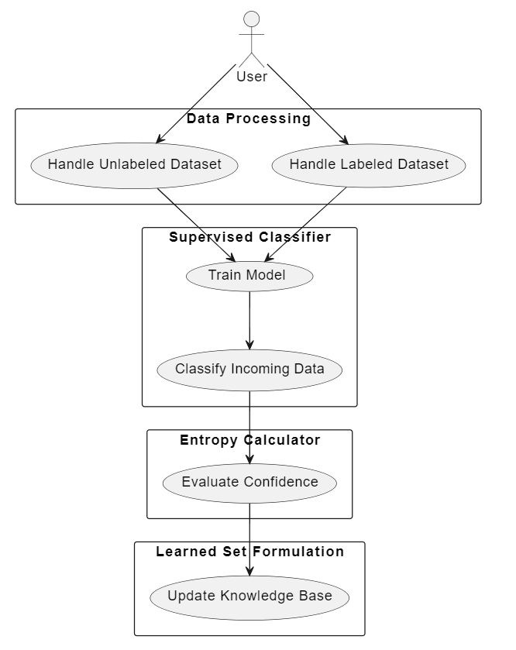
UML Diagrams:
UseCase Diagram:

Slide 16
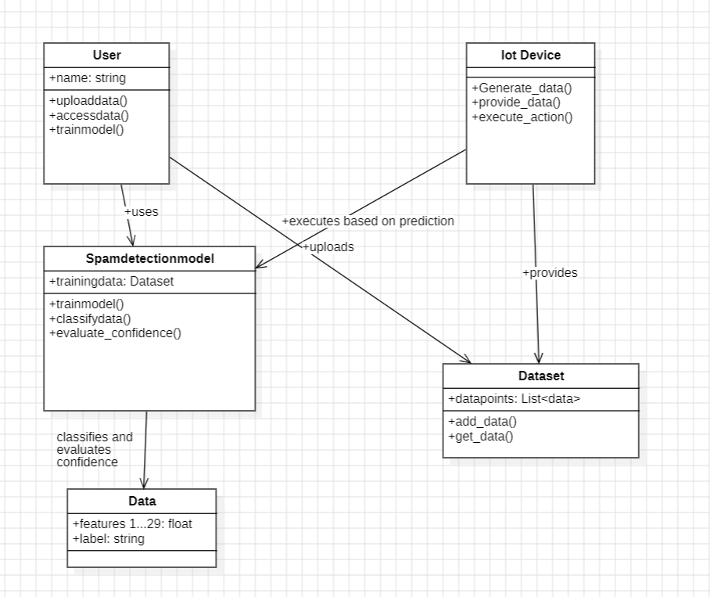
Class Diagram:

Slide 17
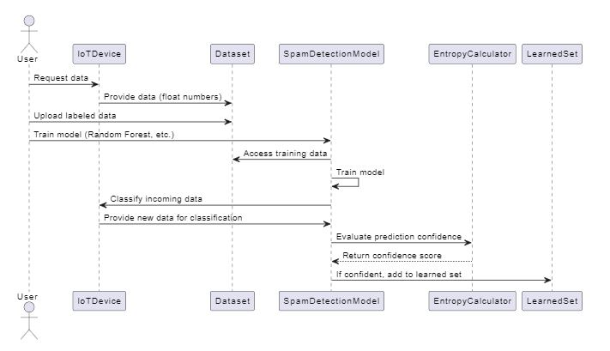
Sequence Diagram:

Slide 18
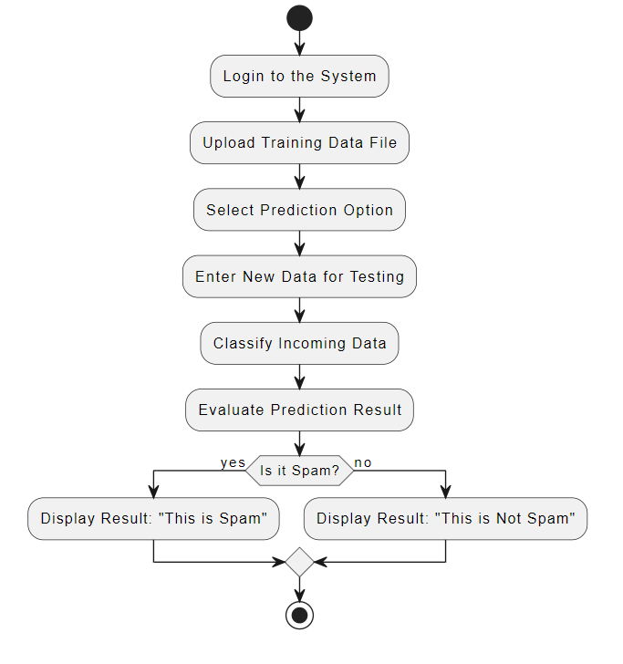
Activity Diagram:

Slide 19
Sample Code:
App.py
import numpy as np
import pandas as pd
from flask import Flask, request, jsonify, render_template, redirect, flash, send_file
from sklearn.preprocessing import MinMaxScaler
from werkzeug.utils import secure_filename
import pickle import numpy as np
import pandas as pd
from sklearn.tree import DecisionTreeClassifier
from sklearn.ensemble import RandomForestClassifier, BaggingClassifier, AdaBoostClassifier, VotingClassifier
app = Flask(__name__) #Initialize the flask App
#forest = pickle.load(open('boosting.pkl','rb'))
model = pickle.load(open('spam.pkl', 'rb'))
@app.route('/')

Slide 20
)#@app.route('/home')
def home():
return render_template('home.html')
@app.route('/prediction', methods = ['GET', 'POST'])
def prediction():
return render_template('prediction.html')
#@app.route('/upload')
def upload_file():
return render_template('BatchPredict.html')
@app.route('/predict',methods=['POST'])
def predict():
int_feature = [x for x in request.form.values()]
final_features = [np.array(int_feature)]
result=model.predict(final_features)
if result == 1:
result = "Spam detected"
else:
result = 'No spam' return render_template('prediction.html', prediction_text= result)
@app.route('/performance')
def performance():
return render_template('performance.html')
if __name__ == "__main__":
app.run(debug=True)

Slide 21
@app.route('/index')
def index():
return render_template('index.html')
@app.route('/chart')
def chart():
return render_template('chart.html')
#@app.route('/future')
def future():
return render_template('future.html')
@app.route('/login')
def login():
return render_template('login.html')
@app.route('/upload')
def upload():
return render_template('upload.html')
@app.route('/preview',methods=["POST"]) def preview():
if request.method == 'POST':
dataset = request.files['datasetfile']
df = pd.read_csv(dataset,encoding = 'unicode_escape')
df.set_index('Id', inplace=True)
return render_template("preview.html",df_view = df)

Slide 22

Sample Code:
HomePage:

Slide 23
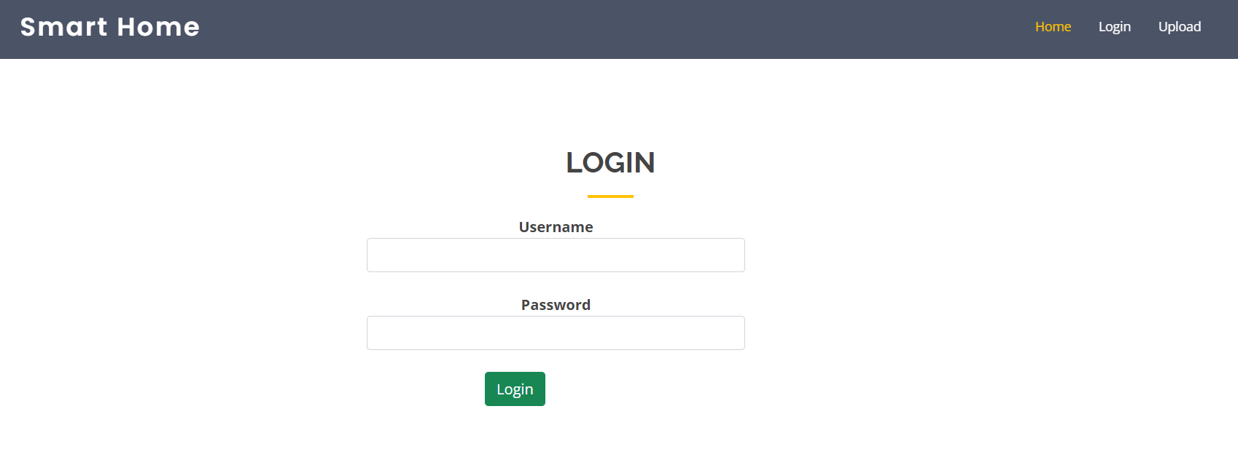
LoginPage:

Slide 24
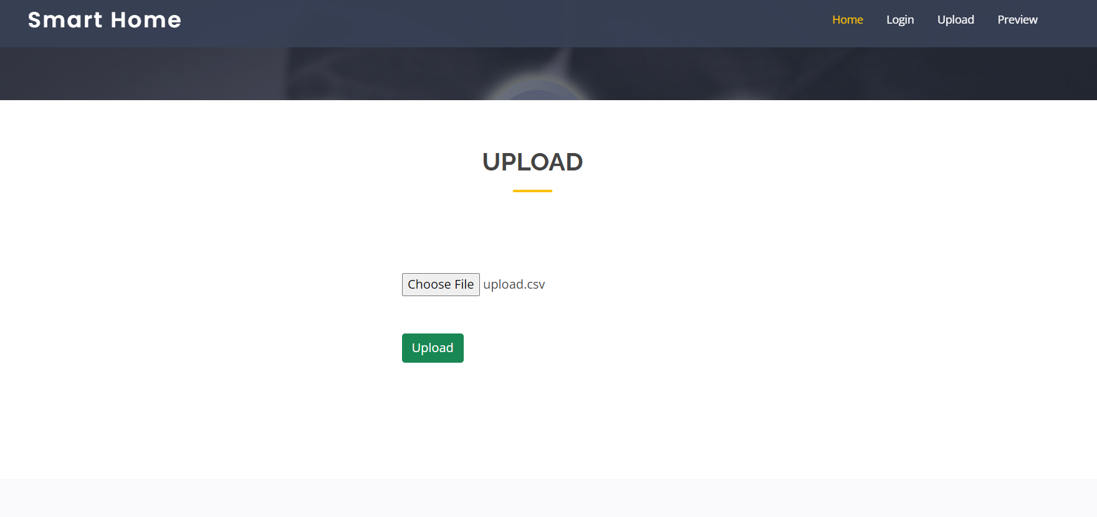
Upload Data:

Slide 25
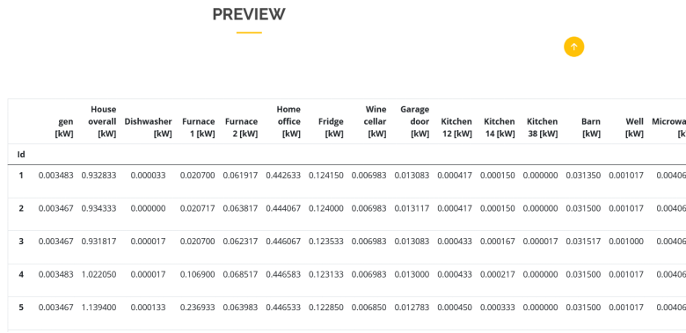
Preview Data:

Slide 26
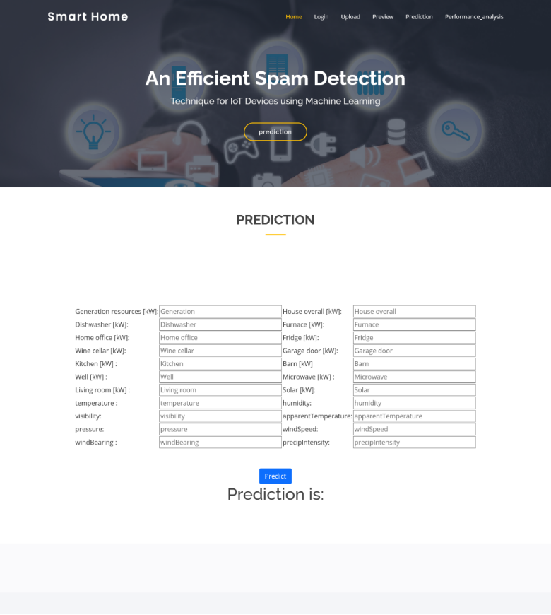
Prediction:

Slide 27
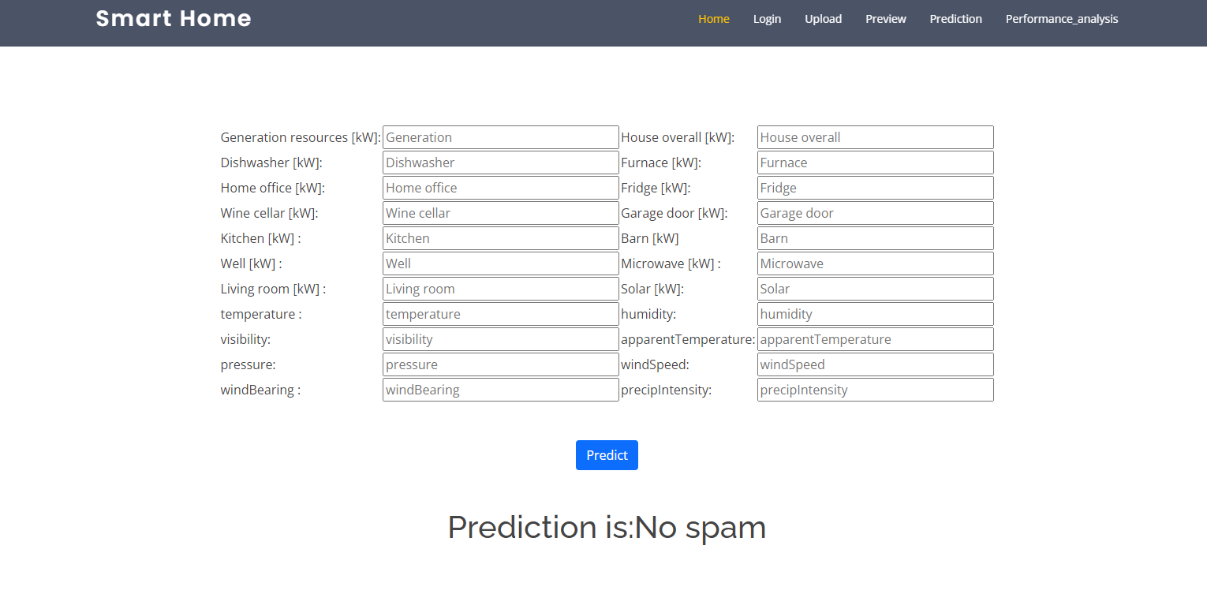
Output:

Slide 28
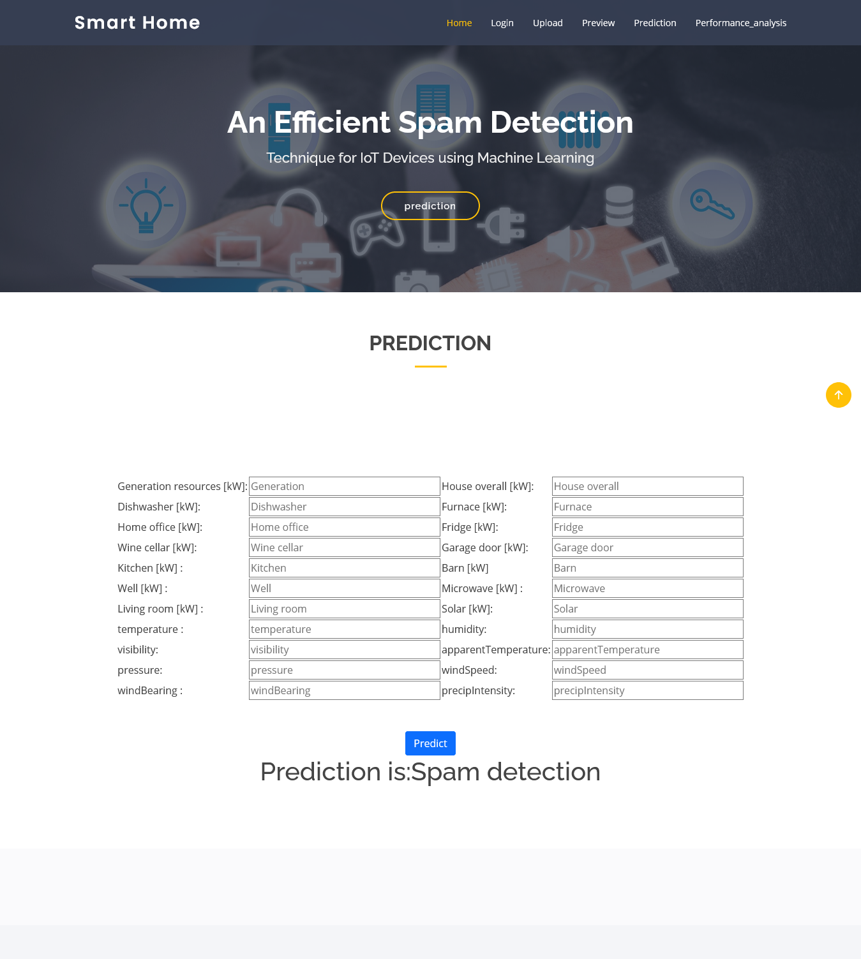

Slide 29
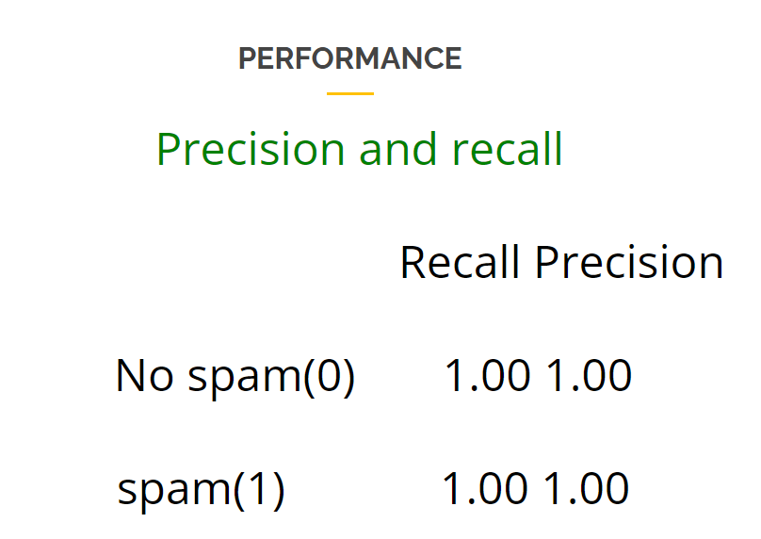
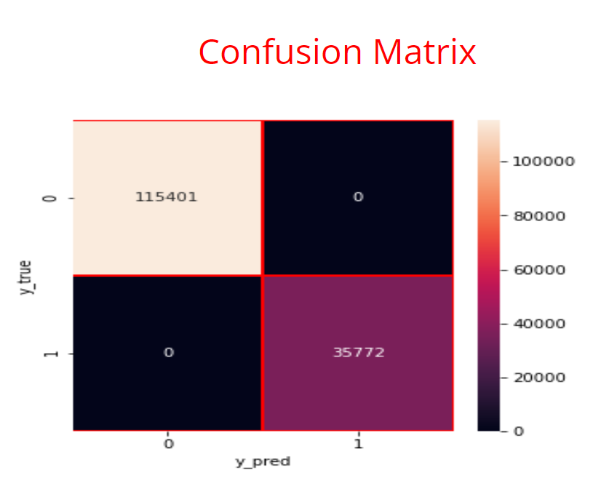
Performance Analysis:

Slide 30
Conclusion:
The spam detection system for IoT devices successfully implements machine learning algorithms to identify and mitigate spam activity. By leveraging labeled and unlabeled datasets, the system enhances the reliability of IoT devices, ensuring the integrity of data transmission. The integration of various machine learning models, coupled with robust evaluation mechanisms, has demonstrated a significant improvement in the accuracy of spam detection. The user-friendly interface allows for seamless interaction, empowering users to upload data, initiate predictions, and access results efficiently.

Slide 31
Future Scope:
The future scope of the spam detection system includes implementing real-time data processing to provide instant feedback on spam detection as IoT devices generate data. Enhancing the model with advanced machine learning techniques, such as deep learning, will improve classification accuracy and adaptability to new spam types. Additionally, developing dynamic learning capabilities will allow the system to continuously update its knowledge base based on incoming data. Integration with broader IoT security frameworks will provide a comprehensive solution, while user customization options for spam detection thresholds will enhance flexibility and user experience.

Slide 32
Reference:
➢ Z.-K. Zhang, M. C. Y. Cho, C.-W.Wang, C.-W.Hsu, C.-K. Chen, and S. Shieh, “Iot security: ongoing challenges and research opportunities,”in 2014 IEEE 7th international conference on service-oriented computing and applications. IEEE, 2014, pp. 230–234.
➢ A. Dorri, S. S. Kanhere, R. Jurdak, and P. Gauravaram, “Blockchain for iot security and privacy: The case study of a smart home,” in 2017 IEEE international conference on pervasive computing and communicationsworkshops(PerCommworkshops). IEEE, 2017, pp. 618–623.
➢ E. Bertino and N. Islam, “Botnets and internet of things security,”Computer, no. 2, pp. 76–79.
➢ C. Zhang and R. Green, “Communication security in internet of thing:preventive measure and avoid ddos attack over iot network,” in Proceedings of the 18th Symposium on Communication

Slide 33
Github Link:
https://github.com/Theachiever05/An-Efficient-Spam-detectection-techniques-for-IOT-devices-using-MachineLearning/tree/main

Slide 34

Thank You
By Batch-09 CSE-A

